Slide 1
Field Trip Lunches
Provided by the LAUSD Food Services Division
2.2.2018

Slide 2
Overview
This training will review the correct procedures to provide reimbursable field trip lunches to students and adults by addressing the following areas:
Standard Operating Procedure
Required Documentation
Role of the Food Services staff
HACCP Requirements

Slide 3
Standard Operating Procedure
The Standard Operating Procedure will provide guidance on:
Meeting the Point of Service requirements
Following the HACCP guidelines
Complying with both USDA and CDE standards
The following designees are responsible to observe these procedures:
Food Service Manager
Coordinating Teacher

Slide 4
Policies
Students shall be provided lunches for field trips according to the USDA, CDE, and HACCP standards.
It is the responsibility of the Food Service Manager to communicate with the school site administration the need for immediate notification of upcoming field trips and provide the Request for Field Trip Lunches form upon request.

Slide 5
Field Trip Menu
No substitutions for required menu items
Juice cannot be substituted for milk
Students with special dietary needs must have a signed Special Diet form on file
Notes:
Note there are no substitutions allowed, only the approved Field Trip Options are to be served.
Now lets talk about the request for field trip form as we continue onto the next slide

Slide 6
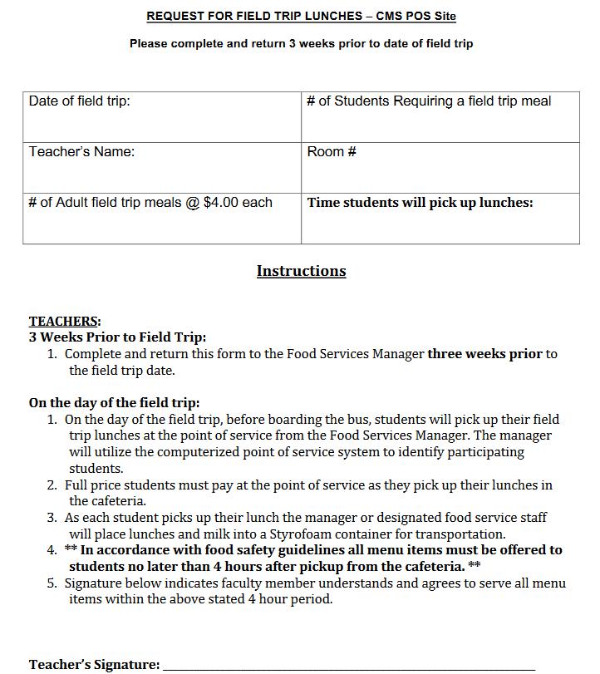
Request for Field Trip Lunches Form
Contains date of field trip
Classroom info
Number of student and adult meals
Time students will pick up lunch
Signature of coordinating teacher
Notes:
Note there are no substitutions allowed, only the approved Field Trip Options are to be served.
Now lets talk about the request for field trip form as we continue onto the next slide

Slide 7
Point of Service Option 1
On the day of the field trip students are to:
Personally collect their lunches in the cafeteria no later than 30 mins prior to bus departure time
FSD staff distribute meals following the counting and claiming procedure

Slide 8
Point of Service Option 2
On the day of the field trip teachers are to:
Use a meal count form to check off students that have received a field trip lunch as a recording of meals
Turn in to the Food Service Manager once completed

Slide 9
Point of Service Option 2
NOTE: If using Option 2, it is the FSM’s responsibility to ensure proper training on POS procedures to the coordinating teacher. If the coordinating teacher is not trained in POS procedures prior to day of field trip, Option 2 may not be applied.

Slide 10
Adult Meal Purchase
Adults may request for a field trip lunch with the class’ initial Request for Field Trip Lunches form.
Number of meals must be clearly indicated
Cost per lunch is $4.91 with tax
Payment will be collected when lunch is picked up from the cafeteria

Slide 11
HACCP Guidelines for Field Trips
Managers will provide BIC bags to store field trip lunches to ensure the quality and safety of food. Meals provided must be served within 4 hours of pick up.
The following are suggestions for cooling:
Take a food approved plastic bag and place it inside a BIC bag, fill with 2 inches of water, and place inside the freezer the night before the field trip
Ice pillows are also available through the warehouse

Slide 12
HACCP Guidelines for Field Trips
Managers will provide BIC bags to store field trip lunches to ensure the quality and safety of food. Meals provided must be served within 4 hours of pick up.
The following are suggestions for cooling:
Take a food approved plastic bag and place it inside a BIC bag, fill with 2 inches of water, and place inside the freezer the night before the field trip
Ice pillows are also available through the warehouse

Slide 13
Activity
A teacher tells the students to place the field trip lunch in their backpack. Is this acceptable?
No, all field trip lunches served by cafeteria must be placed in a BIC bag for temperature and quality control.
The field trip coordinator checkmarks each student that takes a field trip lunch on a classroom roster and submits when they return from the field trip. Is this acceptable?
Yes
A teacher provides students names to FSM prior to field trip day and demands to receive ALL field trip lunches packed in BIC bag without providing a roster. Is this acceptable?
No, all students receiving a field trip meal must be accounted for the day of the field trip using Point of Service Option 1 or Point of Service Option 2 if the teacher has been properly trained in POS procedures.

Slide 14
Recordkeeping Requirements
The Field Trip menu and recipe number of those items served must be recorded on the Production Worksheet.
The completed Request for Field Trip Lunches Form must be attached to the Production Worksheet.
In accordance with HACCP, the signature of the coordinating teacher is required to confirm that students will receive the meals within 4 hours from pick up.

Slide 15
Role of Food Service Manager
Food Service Managers play a key role in ensuring that children receive their lunches and are fed safely. Food Service Managers should:
Communicate the need for field trip notification at least 3 weeks prior to the date by administration, faculty, or teachers
Follow HACCP guidelines
Distribute meals by adhering to correct counting and claiming procedures
Record meals on the Production Worksheet

Slide 16
Questions? Thank you!

